Slide 1

EXPENSE TRACKER
Group members with Student Id
Purvesh Gangapurkar 20104063
Rahul Patil 20104073
Om Chavan 20104056
Ambadas Malegave 20104112
Project Guide
Ms. Rajashri Chaudhari

Slide 2
Contents
Introduction
Objectives
Scope
Features / Functionality
Project Outcomes
Technology Stack
Block Diagram

Slide 3
1. Introduction
Problem Identified :
    The main problem faced by peoples were budget planning.
    The traditional method of record-keeping is tedious and unreliable.
Solution Proposed :
    By Tracking Expenses, it will be very helpful for the people to do their budget planning.
    By using our Expense tracker system users can rely on the computer for all record-keeping and calculations.

Slide 4
2. Objectives
1. To keep a track of Income-Expense on a day-to-day basis.
2. To keep an accurate record of your money inflow and outflow.
3. To save money and help users in planning future investments.
4. To make expense tracking easier by showing all important information in one place.

Slide 5
3. Scope
Can be use by anyone who are willing to manage their expenses.
Aiming to save the money for the future investments and many more.
There is not any range criteria or any kind of profession are focused.

Slide 6
4. Feature /Functionality
User Friendly and Easy To Manage :
    Simple and interactive user interface.
    All important information displayed at one place i.e. Dashboard.
Categories :
    Manage the information according to their Categories.
Data Search :
    Provides the searching facilities based on various factors such as Expense & Type.
Graph and Pie chart :
    Graph and Pie chart is displayed to make the understanding more clear.

Slide 7
4. Feature /Functionality(continued)
5. Expense Summary :
    Detailed summary is displayed.
6. Suggestions :
    Suggestions are provided based on your expenses.
7. Rating:
    Users can rate the application based on their experiences.

Slide 8
5. Outcome of Project
User Can log In.
User can keep track of his/her expenses.
Users will be able to manage his/her expenses correctly.
Users will get suggestions for investing his/her savings.
Our Expense Tracker system can keep a record of many users at a time.

Slide 9
6. Technology Stack
Front-end: Python Tkinter
Database: Postgresql
Integrated Development Environment (IDE): Pycharm
Platform: Windows 10/11

Slide 10
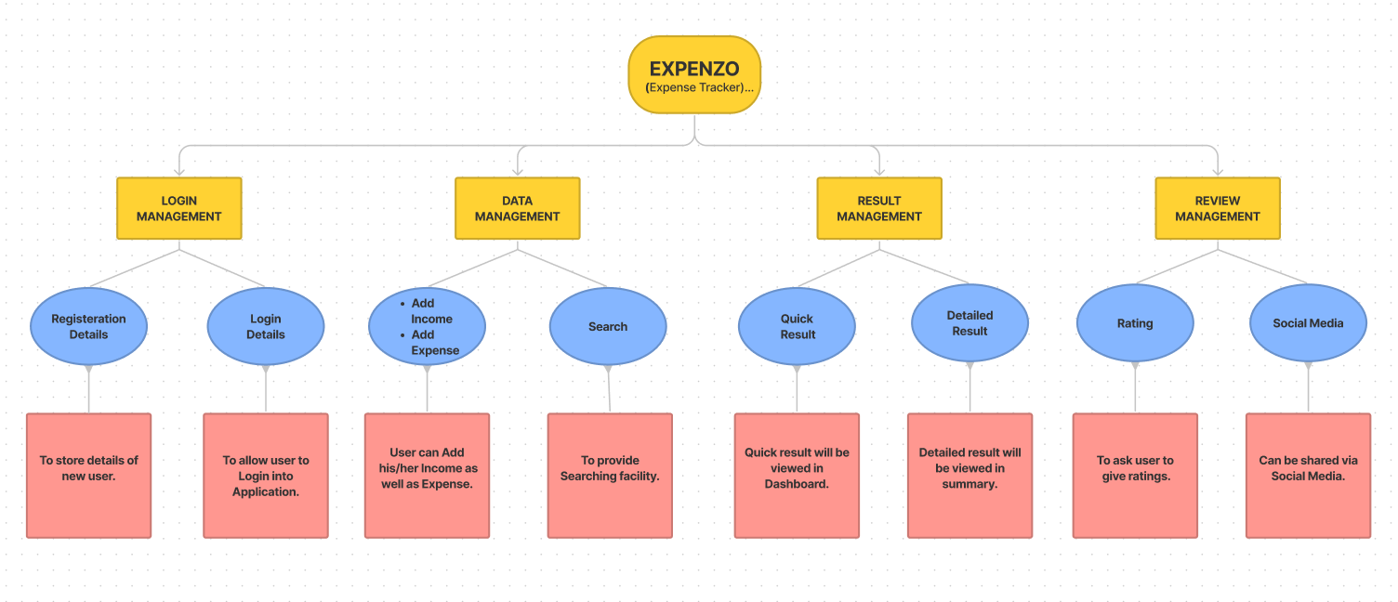
7. Block Diagram ( if applicable)

Slide 11
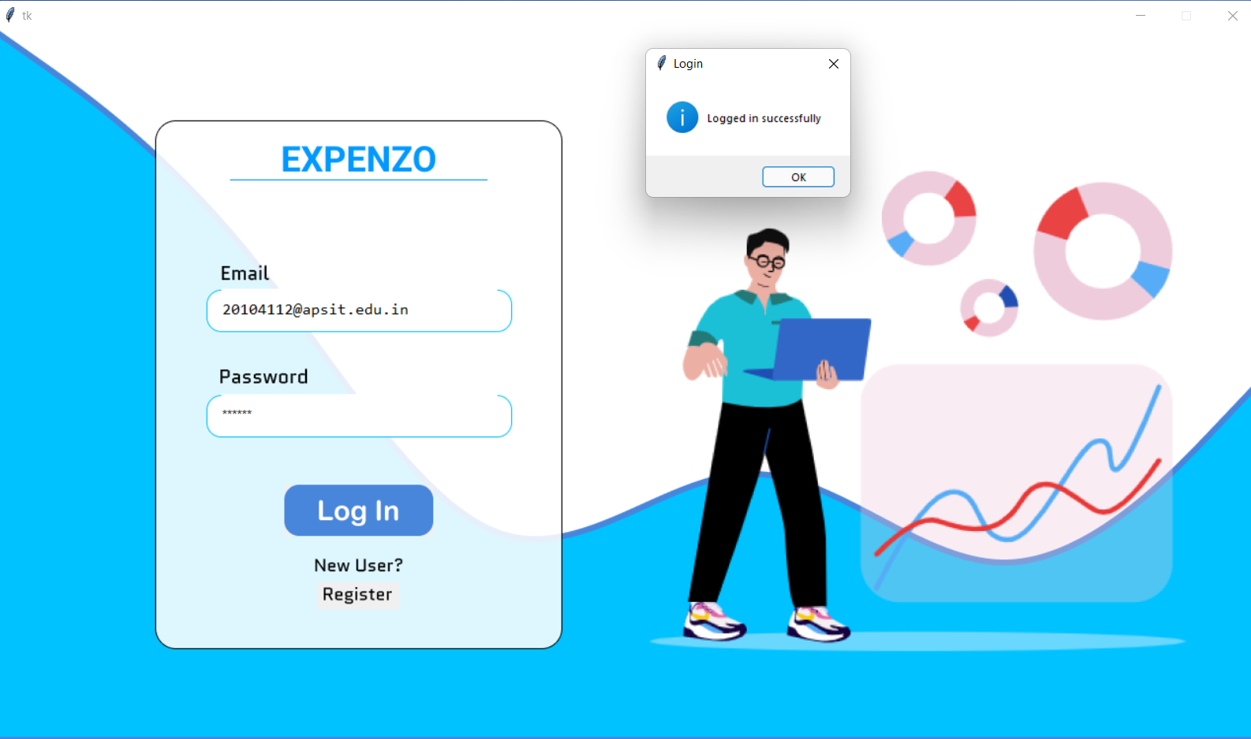
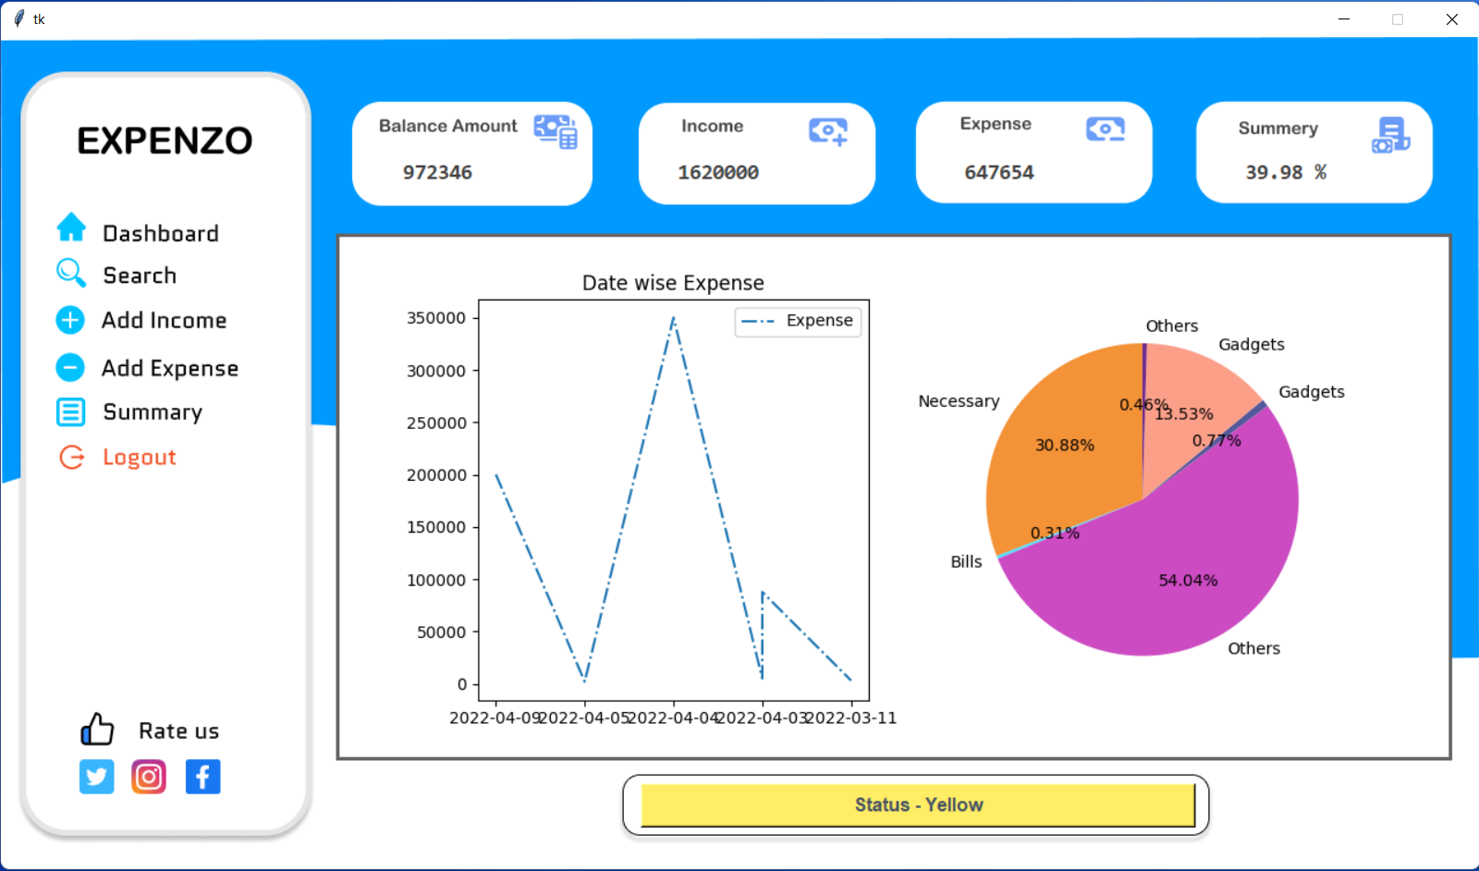
8. Design

Slide 12
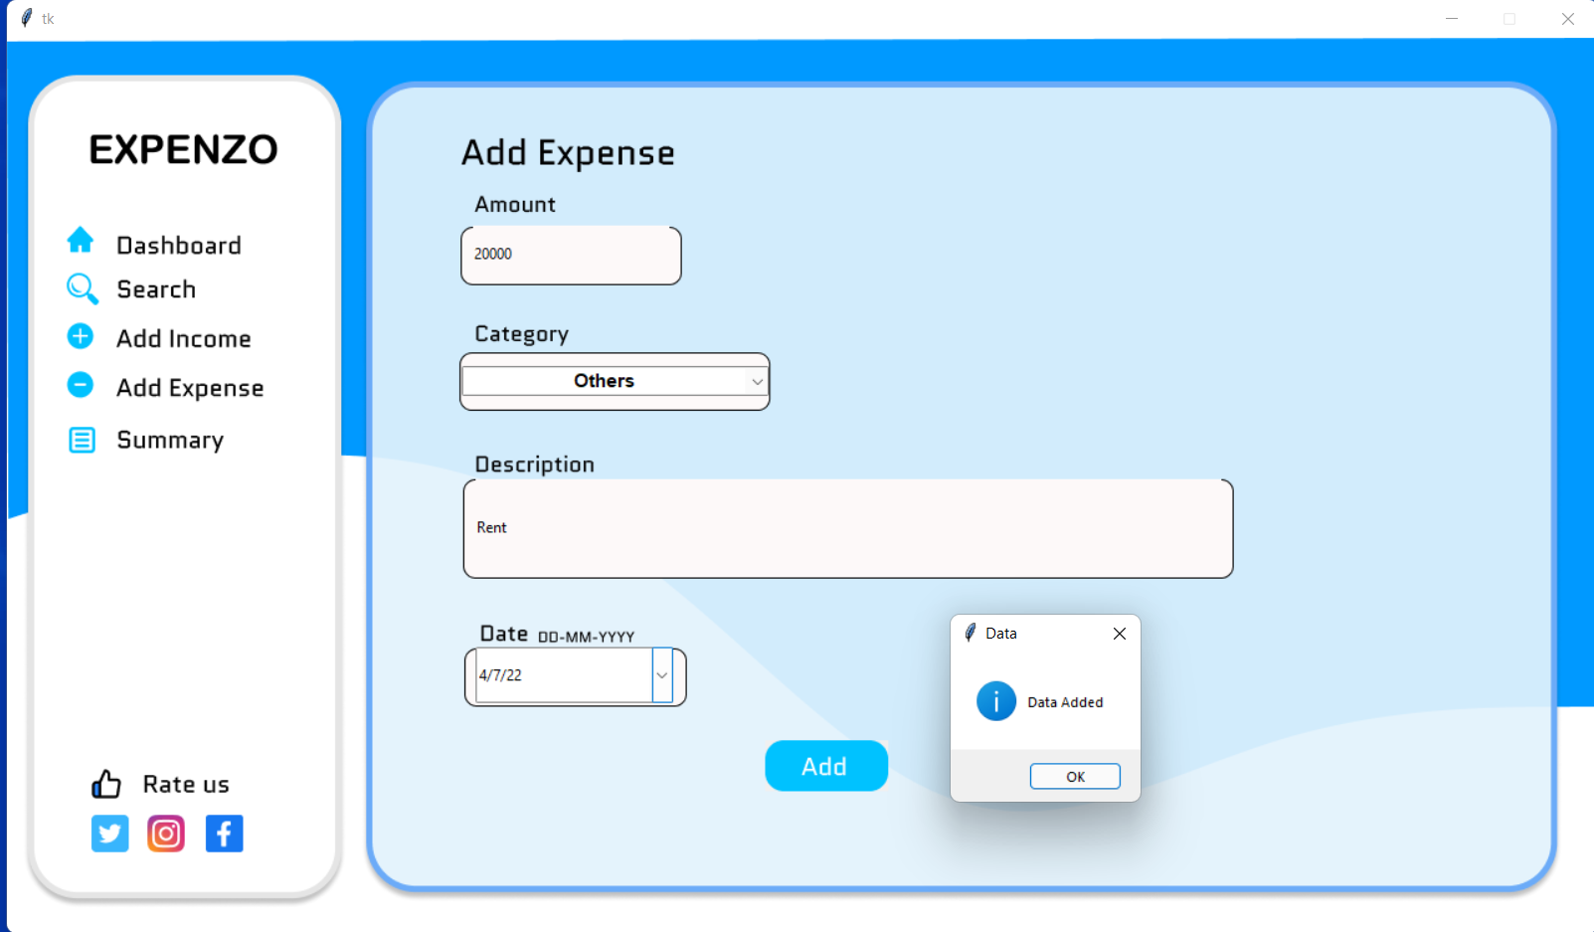
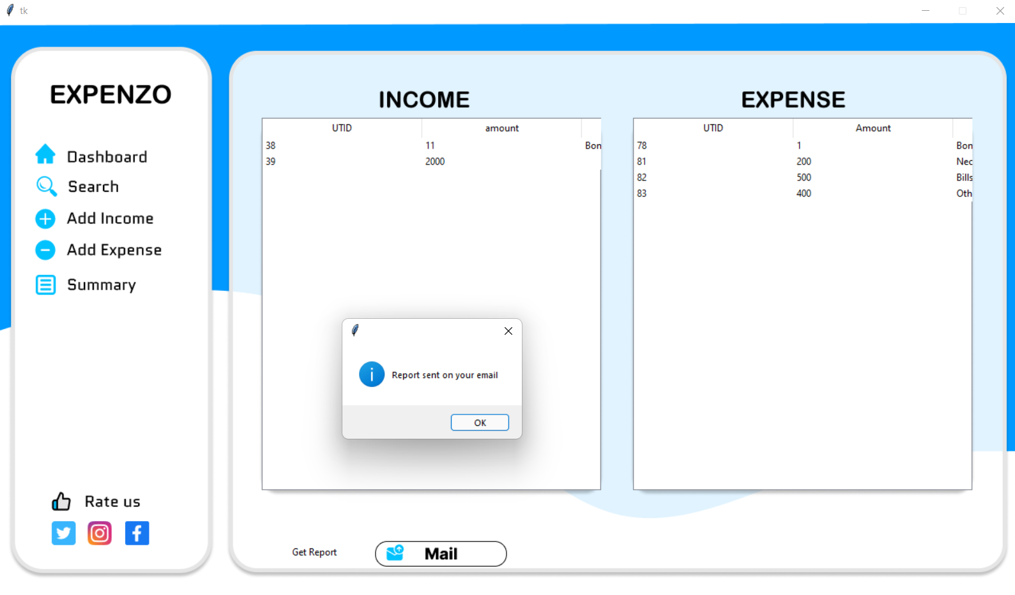
8. Design continued

Slide 13
Thank You...!!

